Slide 1
Bochum goes LBD
Group 1

Slide 2
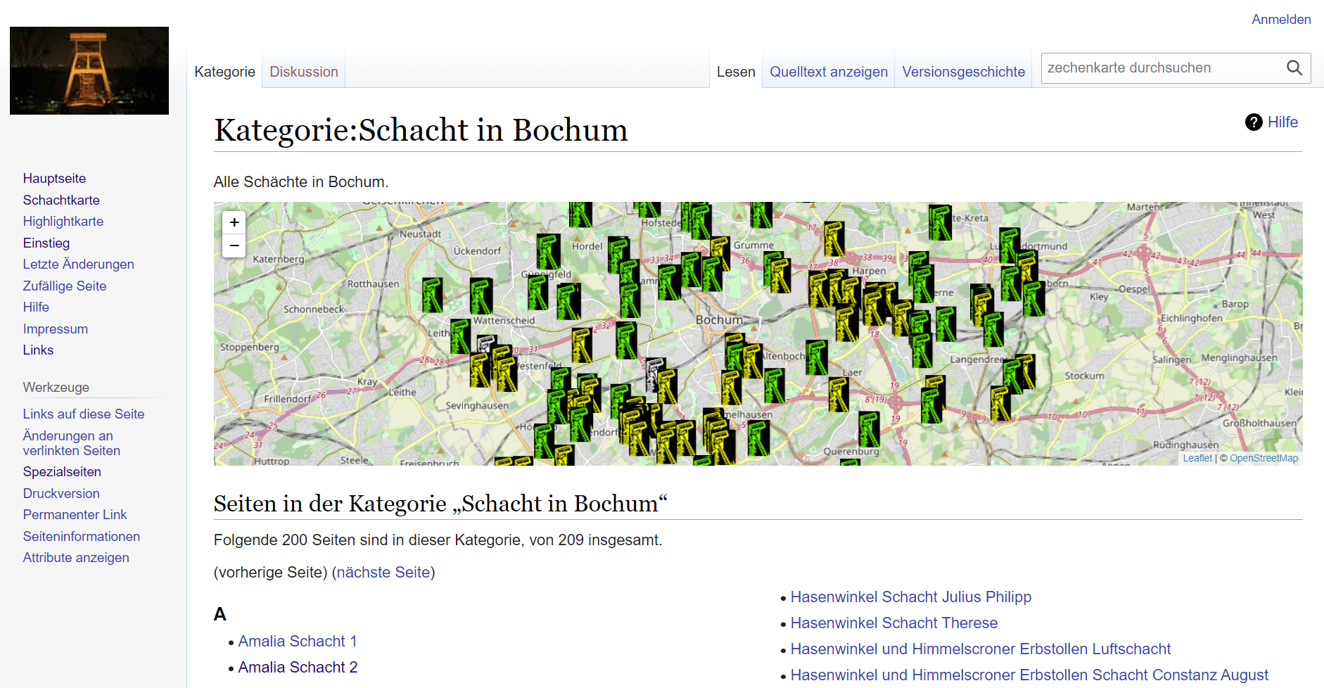
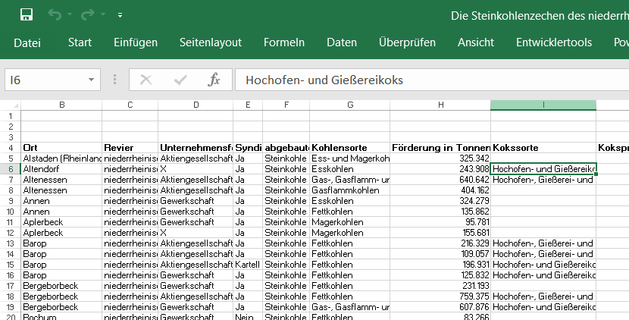
Data Sources
Wiki Page
Excel Sheet
Shafts with Location
Mines with production data

Slide 3
What we want to solve?
Link different Datasources and Query it in a GIS environment with the Usage of Linked Data

Slide 4
Linked Data Structure
A picture and explanation of the datastrucutre

Slide 5
Bridging the gap: Wikipages and Excel
Explain in detail how it can be combined
1 Mine can have several Schachs (1:*)

